Slide 1
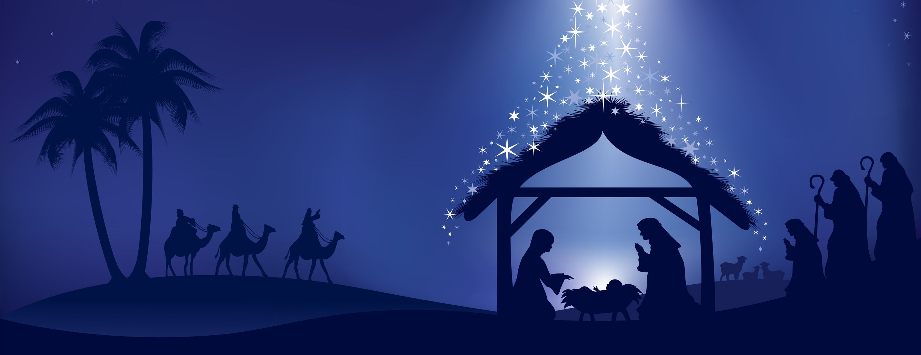
AWAY
IN A MANGER

Slide 2

Away in a manger, no crib for a bed,
the little Lord Jesus laid down His sweet head.
The stars in the bright sky looked down where He lay,
the little Lord Jesus asleep on the hay.

Slide 3
2. The cattle are lowing, the baby awakes,
but little Lord Jesus, no crying He makes.
I love Thee, Lord Jesus, look down from the sky
and stay by my cradle till morning is nigh.

Slide 4
3. Be near me, Lord Jesus, I ask Thee to stay.
Close by me forever and love me, I pray.
Bless all the dear children in Thy tender care
and take us to heaven to live with Thee there.

